Slide 1
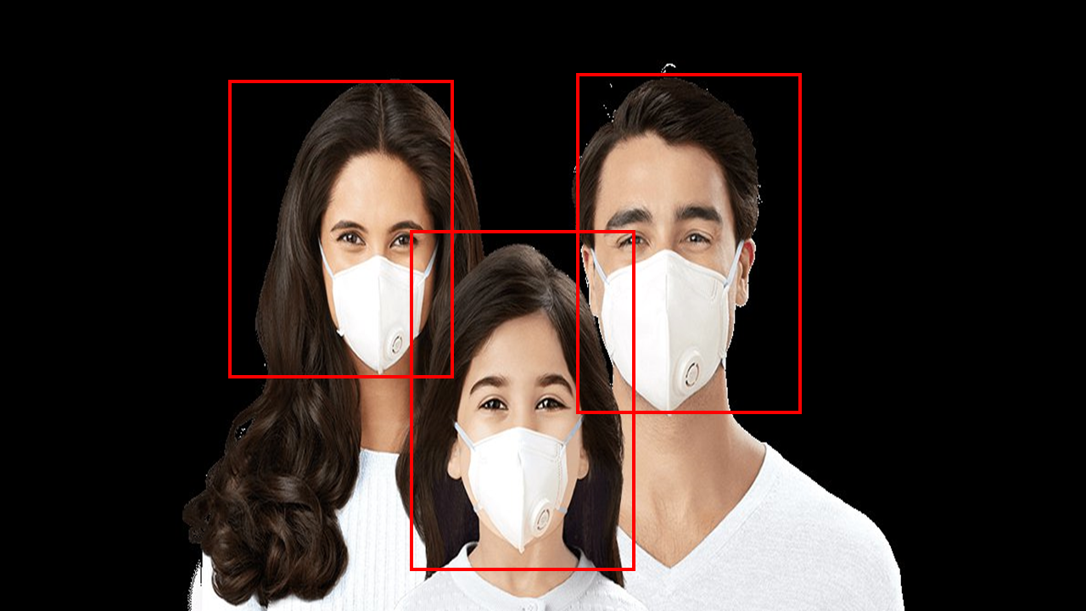
FACEMASK DETECTION SYSTEM
BY:
IKE-OKORO EKENE
NWARU STANLEY
Adedeji TORIADE
AKINYELE GBENGA
EHIZOKHALE IKHIANOSEN

Slide 2
PROJECT DESCRIPTION
The face mask detection system as the name implies is a system which detects if a person is wearing a facemask and if so, a door is open otherwise, the door remains shut.

Slide 3
COMPONENTS USED
ESP32 CAM
PROXIMITY SENSOR
ARDUINO UNO
JUMPER WIRES
SERVOR MOTOR

Slide 4
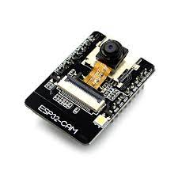
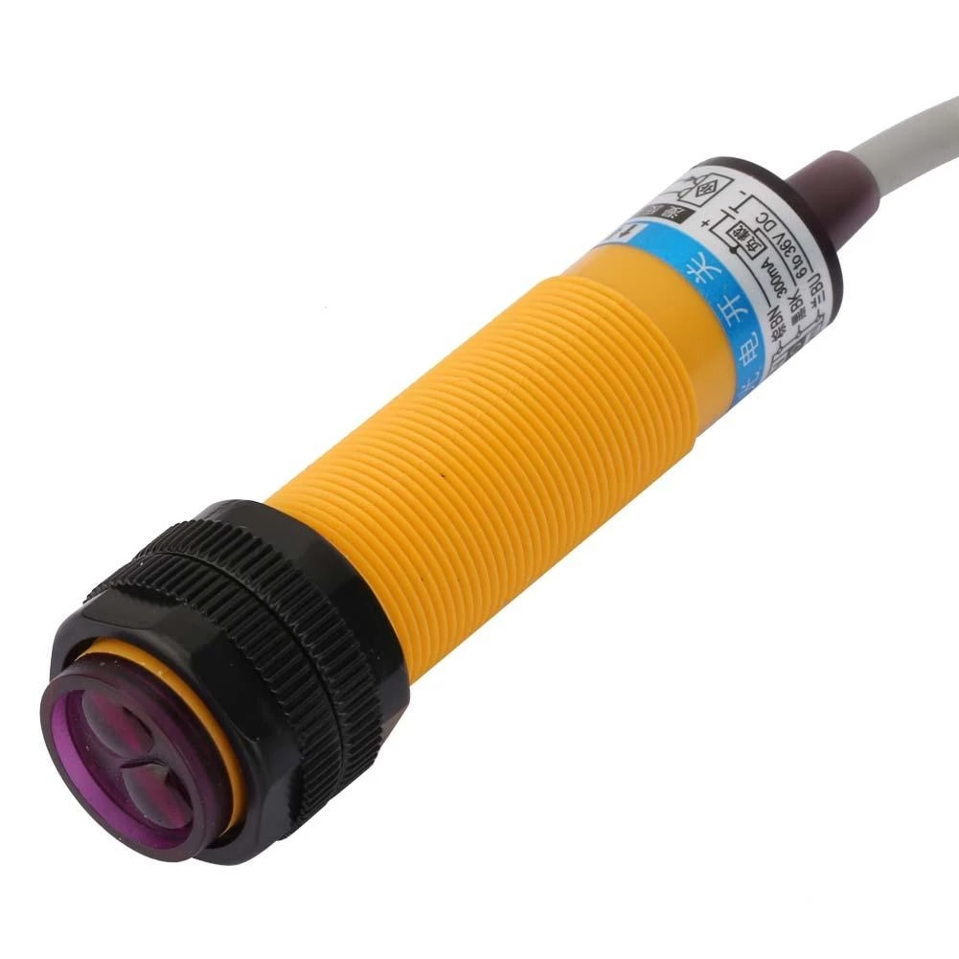
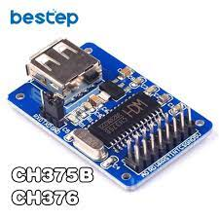
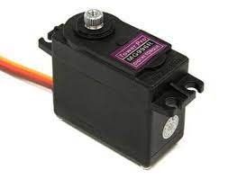
ESP32 Cam
Proximity Sensor
USB Module
Servo Motor

Slide 5
PROBLEM SOLVED BY PROJECT
In regards to the current global pandemic , this system can be integrated into public places to avoid further spread of the virus.
The system can also be used in medical theatres to ensure that no one enters the theatre without a face mask.

Slide 6
LIMITATIONS AND PROBLEMS ENCOUNTERED
The accuracy in detection of facemasks of the system like any other system is not 100% accurate but works relatively well.
The major problem encountered was uploading codes the esp32 which was later solved by waiting for 10 second after clicking the upload button before clicking the reset button on the esp32.
The power being consumed by the servo motor is greater than that which the servo can give, the servo was then connected to a different power source but leaving the signal pin connected to the esp32.

Slide 7
Servo Motor
Proximity Sensor
ESP32 Cam
USB Module

Slide 8
Thank you!

